Slide 1

Mijoz server aloqasi

Slide 2
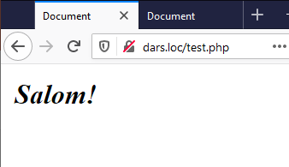
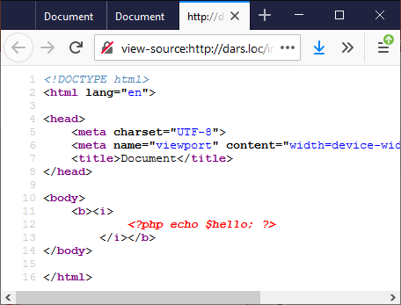
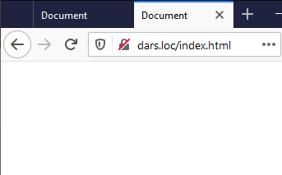
PHPdan HTMLga ma'lumot uzatish
PHP (test.php):
<?php
$hello = 'Salom!';
require_once('index.html');
HTML (index.html):
<!DOCTYPE html>
<html lang="en">
... <body>
<b><i>
<?php echo $hello; ?>
</i></b>
</body>
</html>

Slide 3
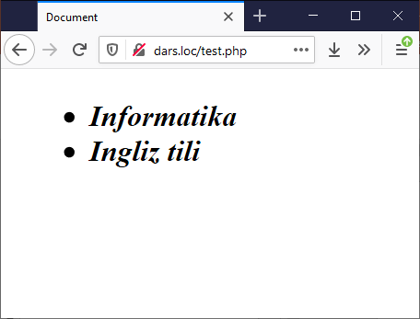
PHPdan HTMLga ma'lumot uzatish
PHP (test.php):
<?php
$list = array("Informatika", "Ingliz tili");
require_once('index.html');
HTML (index.html):
<!DOCTYPE html>
<html lang="en">
... <body>
<ul>
<?php foreach ($list as $fan) { ?>
<li>
<b><i>
<?= $fan; ?>
</i></b>
</li>
<?php } ?>
</ul>
</body>
</html>

Slide 4
HTMLdan PHPga ma'lumot uzatish
Formalar orqali amalga oshiriladi.
Metod aniqlanishi shart (GET, POST).
Action atributi orqali forma jo'natiladigan server manzili ko'rsatilishi kerak (ko'rsatilmasa joriy manzilga jo'natiladi).
Forma elementlarida name, value atributlari aniqlanishi kerak.
Forma serverga jo'natilishi uchun "submit" tipli element aniqlangan bo'lishi kerak (yoki ushbu tipli element aniqlanmaganda JS orqali ham formani serverga yuborish mumkin).
Forma orqali fayl jo'natilayotganda form elementi atributida enctype='multipart/form-data' o'rnatilishi shart.
Serverda ma'lumotlar $_GET, $_POST, $_FILES, $_REQUEST massivlarida saqlanadi.
Serverda ma'lumotlarni tekshirishda empty(), isset() va is_null() funksiyalaridan foydalanish mumkin.
 | “” | “apple” | NULL | FALSE | 0 | undefined
empty() | TRUE | FALSE | TRUE | TRUE | TRUE | TRUE
is_null() | FALSE | FALSE | TRUE | FALSE | FALSE | ERROR
isset() | TRUE | TRUE | FALSE | TRUE | TRUE | FALSE

Slide 5
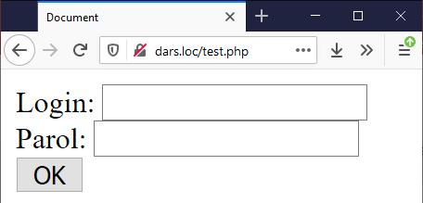
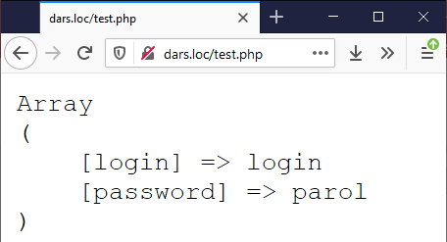
HTMLdan PHPga ma'lumot uzatish
index.html:
<form method="POST" action="/test.php">
Login: <input type="text" name="login">
Parol: <input type="password" name="password">
<input type="submit" value="OK">
</form>
test.php: <?php
if (!empty($_POST)) {
echo '<pre>';
print_r($_POST);
die();
}
require_once('index.html');

Slide 6
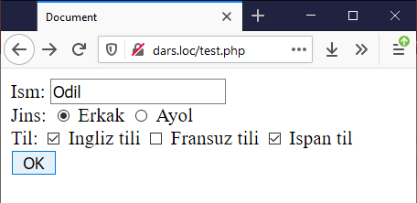
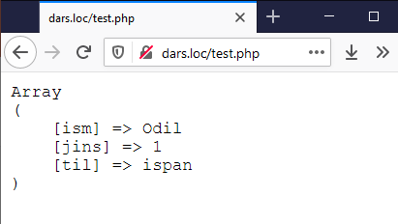
HTMLdan PHPga ma'lumot uzatish
index.html:
<form method="POST" action="/test.php">
Ism: <input type="text" name="ism"><br />
Jins: <input type="radio" name="jins" value="1"> Erkak
<input type="radio" name="jins" value="0"> Ayol<br />
Til: <input type="checkbox" name="til" value="ingliz"> Ingliz tili
<input type="checkbox" name="til" value="fransuz"> Fransuz tili
<input type="checkbox" name="til" value="ispan"> Ispan til<br />
<input type="submit" value="OK">
</form>
test.php: <?php
if (!empty($_POST)) {
echo '<pre>';
print_r($_POST);
die();
}
require_once('index.html');

Slide 7
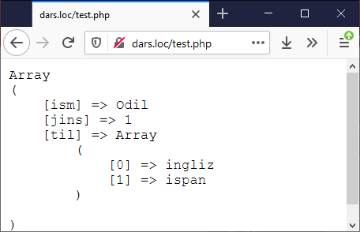
HTMLdan PHPga ma'lumot uzatish
index.html:
<form method="POST" action="/test.php">
Ism: <input type="text" name="ism"><br />
Jins: <input type="radio" name="jins" value="1"> Erkak
<input type="radio" name="jins" value="0"> Ayol<br />
Til: <input type="checkbox" name="til[]" value="ingliz"> Ingliz tili
<input type="checkbox" name="til[]" value="fransuz"> Fransuz tili
<input type="checkbox" name="til[]" value="ispan"> Ispan til<br />
<input type="submit" value="OK">
</form>
test.php: <?php
if (!empty($_POST)) {
echo '<pre>';
print_r($_POST);
die();
}
require_once('index.html');

Slide 8
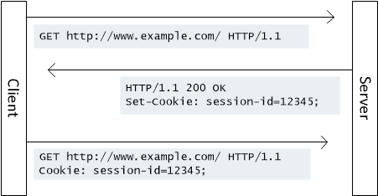
Kuki (Cookie)
Kuki – foydalanuvchi brauzerida berilganlarni saqlash mexanizmi. Kukilarni setcookie() yoki setrawcookie() funksiyalari orqali yuklash mumkin. Ushbu funksiyalar HTTP sarlavha hisoblanadi va berilganlarni brauzerga chiqarishdan oldin chaqirilishi zarur. Mijoz brauzeri tomonidan serverga jo'natilgan barcha kukilar $_COOKIE super global massivida saqlanadi.

Slide 9
Kuki (Cookie)
Funksiyalar sintaksisi:
setcookie( string $name, string $value = "", int $expires = 0, string $path = "", string $domain = "", bool $secure = false, bool $httponly = false) : bool
setcookie( string $name, string $value = "", array $options = []) : bool
name – kuki nomi
value – kuki qiymati (mijozning brauzerida saqlanadi)
expires – kukining amal qilish muddati (time()+60*60*24*30 – 1kun muddatda, agar ushbu qiymat ko'rsatilmasa, sessiya tugashi bilan (brauzer yopilganda) kuki o'chiriladi)
path – kukiga huquqi bor bo'ladigan serverdagi direktoriya, agar '/' ko'rsatilsa domendagi ixtiyoriy joydan huquq bor bo'ladi, '/foo/' – domendagi foo direktoriyasi va uning voris direktoriyalaridan (masalan, '/foo/baz/') huquq bor
domain – kukiga huquqi bor domenni belgilash
secure – kukilar faqat himoyalangan bog'lanish (HTTPS) orqali uzatiladi
httponly – kukilar faqat HTTP protokoli orqali uzatiladi, bunda JS orqali kukini o'qishning imkoni to'xtatiladi.
* Kukini o'chirish uchun uni o'rnatishdagi parametrlar qanday berilgan bo'lsa shunday berilishi, faqat value sifatida bo'sh satr yoki false qiymati berilishi kerak

Slide 10
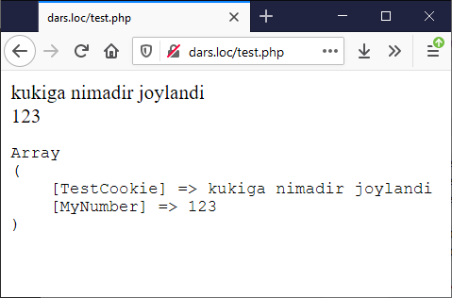
Kuki (Cookie)
<?php
$value = 'kukiga nimadir joylandi';
setcookie("TestCookie", $value);
setcookie("TestCookie", $value, time() + 3600);
setcookie("MyNumber", 123, time() + 10);
echo $_COOKIE["TestCookie"] . "<br/>";
echo $_COOKIE["MyNumber"];
echo "<pre>";
print_r($_COOKIE);

Slide 11
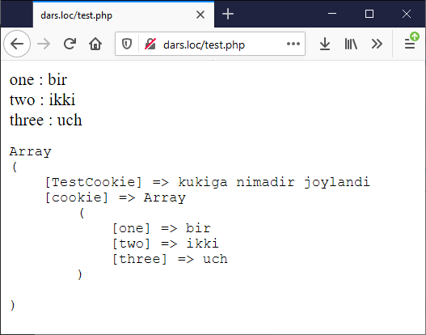
Kuki (Cookie) va massiv
<?php
setcookie("cookie[one]", "bir");
setcookie("cookie[two]", "ikki");
setcookie("cookie[three]", "uch");
if (isset($_COOKIE['cookie'])) {
foreach ($_COOKIE['cookie'] as $name => $value) {
$name = htmlspecialchars($name);
$value = htmlspecialchars($value);
echo "$name : $value <br />\n";
}
}
echo "<pre>";
print_r($_COOKIE);

Slide 12
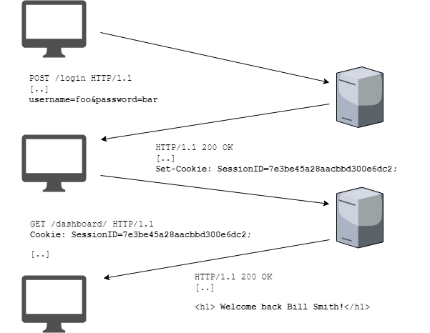
Sessiya (Session)
Sessiya – foydalanuvchilar uchun alohida ma'lumotlarni saqlash mexanizmi. Sessiya identifikatori kukida, yoki kukida saqlash imkoni bo'lmasa urlda saqlanadi.
Sessiya amalga oshirish uchun kerakli php fayl boshida session_start() funksiyasini chaqirish kerak.
Sessiya – massiv, $_SESSION super global o'zgaruvchisi orqali ishlatiladi, ushbu massiv kaliti son bo'lishi mumkin emas.
Sessiyadan ma'lumotlarni o'chirish uchun unset($_SESSION['var']) buyrug'ini amalga oshirish kerak.
Sessiyani to'liq o'chirish uchun session_destroy() buyrug'ini amalga oshirish kerak.

Slide 13
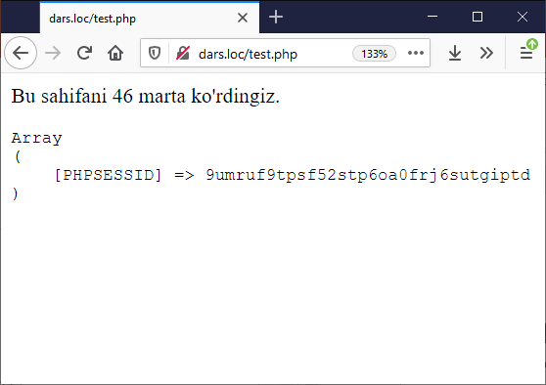
Sessiya (Session)
<?php
session_start();
if (empty($_SESSION['count'])) {
$_SESSION['count'] = 1;
} else {
$_SESSION['count']++;
}
?>
<p>Bu sahifani <?php echo $_SESSION['count']; ?> marta ko'rdingiz.</p>
<?php
echo "<pre>";
print_r($_COOKIE);
?>

Slide 14
Sessiya (Session) va vaqt
// sessiyani tugashini aniqlash va o'chirish
session_start();
if (!$_SESSION['auth']) {
header('location:index.php');
} else {
$currentTime = time();
if ($currentTime > $_SESSION['expire']) {
session_unset();
session_destroy();
header('location:index.php');
}
// hali tugamagan
}
// sessiyani tugash vaqti bilan yaratish
if($total != 0) {
session_start();
$_SESSION['auth'] = true;
$_SESSION['start'] = time();
$_SESSION['expire'] = $_SESSION['start'] + (40 * 60);
header('location:homePage.php');

Slide 15
Kuki vs Sessiya
 | Sessiya | Kuki
Ishlash prinsipi | Foydalanuvchi brauzerida faqat sessiya ID nomeri saqlanadi, qolgan barcha ma'lumotlar serverda saqlanadi | Barcha ma'lumotlar foydalanuvchi brauzerida saqlanadi
Ish vaqti | Foydalanuvchi tizimdan chiqqanda yoki brauzerni yopganda tugaydi | Foydalanuvchi tomonidan aniqlanadi.
Havfsizlik | Sessiya qisqa vaqt saqlanadi, shuningdek, shifrlangan holatda saqlanadi | Matnli fayl ko'rinishida saqlanadi.
Ishlash vaqti sozlamalari (php.ini faylda, sekundlarda):
session.gc_maxlifetime = 172800
session.cookie_lifetime = 172800

Slide 16
Supergloballar
$GLOBALS – barcha global ko'rinish sohasidagi o'zgaruvchilarni ko'rish uchun ishlatiladi
$_SERVER – server va muhit haqidagi ma'lumotlarni saqlovchi massiv
$_GET – HTTP GET o'zgaruvchilarini saqlovchi massiv
$_POST – HTTP POST o'zgaruvchilarini saqlovchi massiv
$_FILES – HTTP POST metodi orqali yuklangan fayllar massivi
$_COOKIE – kukilarni saqlovchi massiv
$_SESSION – sessiya o'zgaruvchilarini saqlovchi massiv
$_REQUEST – HTTP so'rov o'zgaruvchilarini saqlovchi massiv
$_ENV – muhit o'zgaruvchilari massivi

Slide 17
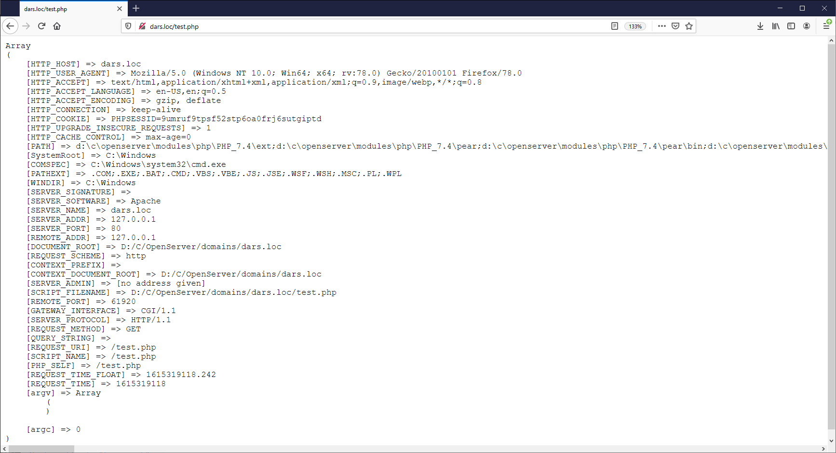
Supergloballar - $_SERVER

Slide 18
Supergloballar - $_FILES
Fayllarni yuklashning qo'shimcha sozlamalari php.ini sozlamalar faylidagi file_uploads, upload_max_filesize, upload_tmp_dir, post_max_size и max_input_time direktivalari orqali boshqariladi.
$_FILES global massivi userfile nomli forma elementi uchun quyidagicha bo'ladi:
$_FILES['userfile']['name'] – faylning mijoz kompyuteridagi original nomi.
$_FILES['userfile']['type'] – brauzer taqdim etsa faylning mime-tipi. Masalan, "image/gif".
$_FILES['userfile']['size'] – faylning baytdagi o'lchami.
$_FILES['userfile']['tmp_name'] – faylning serverda saqlangan vaqtincha nomi.
$_FILES['userfile']['error'] – faylni yuklash jarayonidagi xatolik kodi.
move_uploaded_file( string $from, string $to) : bool – faylni ko'chirish uchun funksiya

Slide 19
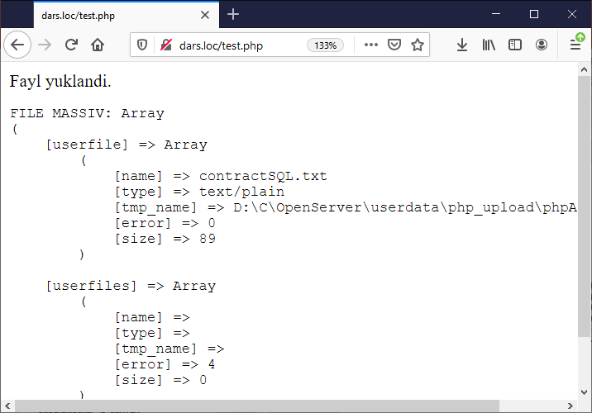
Supergloballar - $_FILES
<form method="POST" action="/test.php" enctype="multipart/form-data">
<input type="file" name="userfile">
<input type="file" name="userfiles[]" multiple> <input type="submit" value="OK">
</form>
<?php
$uploaddir = '/files/';
$uploadfile = __DIR__ . $uploaddir . basename($_FILES['userfile']['name']);
if (move_uploaded_file($_FILES['userfile']['tmp_name'], $uploadfile)) {
echo "Fayl yuklandi.\n";
} else {
echo "Fayl yuklanmadi!\n";
} echo '<pre>FILE MASSIV: ';
print_r($_FILES);

Slide 20
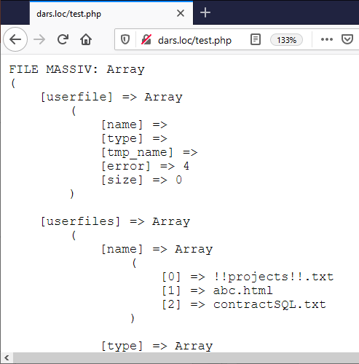
Supergloballar - $_FILES
<form method="POST" action="/test.php" enctype="multipart/form-data">
<input type="file" name="userfile">
<input type="file" name="userfiles[]" multiple> <input type="submit" value="OK">
</form>
<?php
$uploaddir = '/files/';
foreach ($_FILES["userfiles"]["error"] as $key => $error) {
if ($error == UPLOAD_ERR_OK) {
$tmp_name = $_FILES["userfiles"]["tmp_name"][$key];
$name = basename($_FILES["userfiles"]["name"][$key]);
$dest_name = __DIR__ . $uploaddir . $name;
move_uploaded_file($tmp_name, $dest_name);
}
} echo '<pre>FILE MASSIV: ';
print_r($_FILES);

Slide 21
Savollar?

